Slide 1
DOM XSS jQuery

Slide 2
Problem with jQuery
jQuery will evaluate <script> tags when an HTML string is passed into it. Makes XSS easier than if you use native methods.
For example the following will show an alert:
$(‘#myDiv’).html(‘<script>alert(“Hi”);</script>’);
However, do the same thing using the browsers native innerHTML, and nothing happens
The native browser functionality is to ignore <script> elements that added via an HTML string
Demo should show two alert tags but innerHTML won’t work

Slide 3
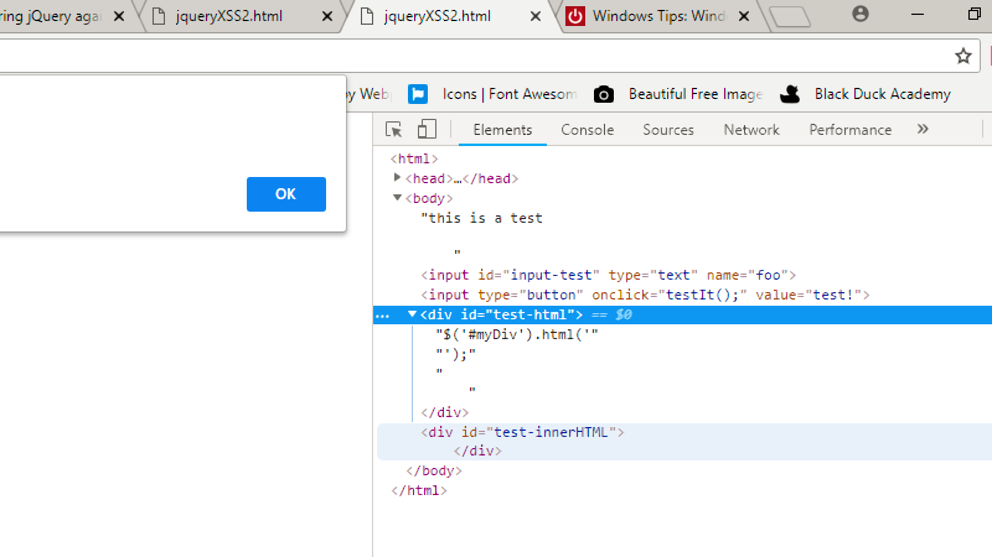
$(‘#myDiv’).html(‘<script>alert(“Hi”);</script>’);

Slide 4
Work-around
Script pseudo-protocols can be used in various locations to execute inline script
For example: <iframe src=javascript:alert(1)>
This attack is effectively the same as a conventional XSS attack; the attacker simply uses the src attribute of the injected iframe element as a vehicle to run some javascript code in the attacked page.

Slide 5
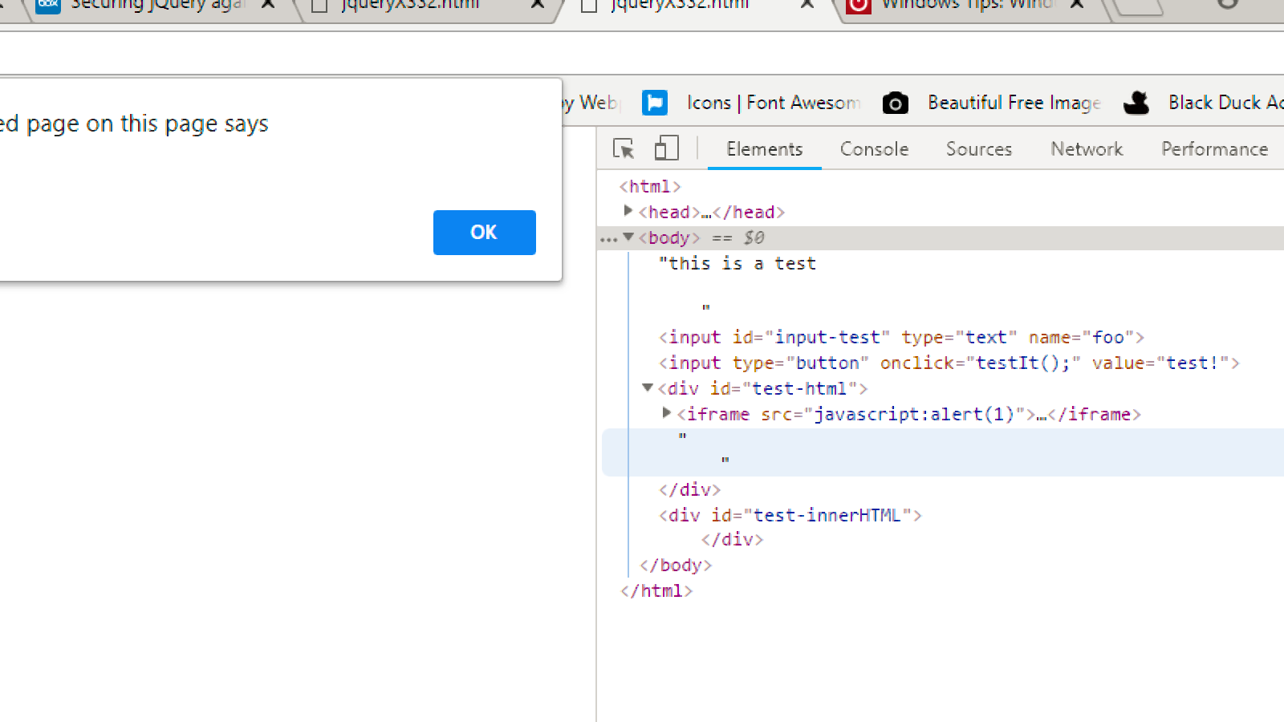
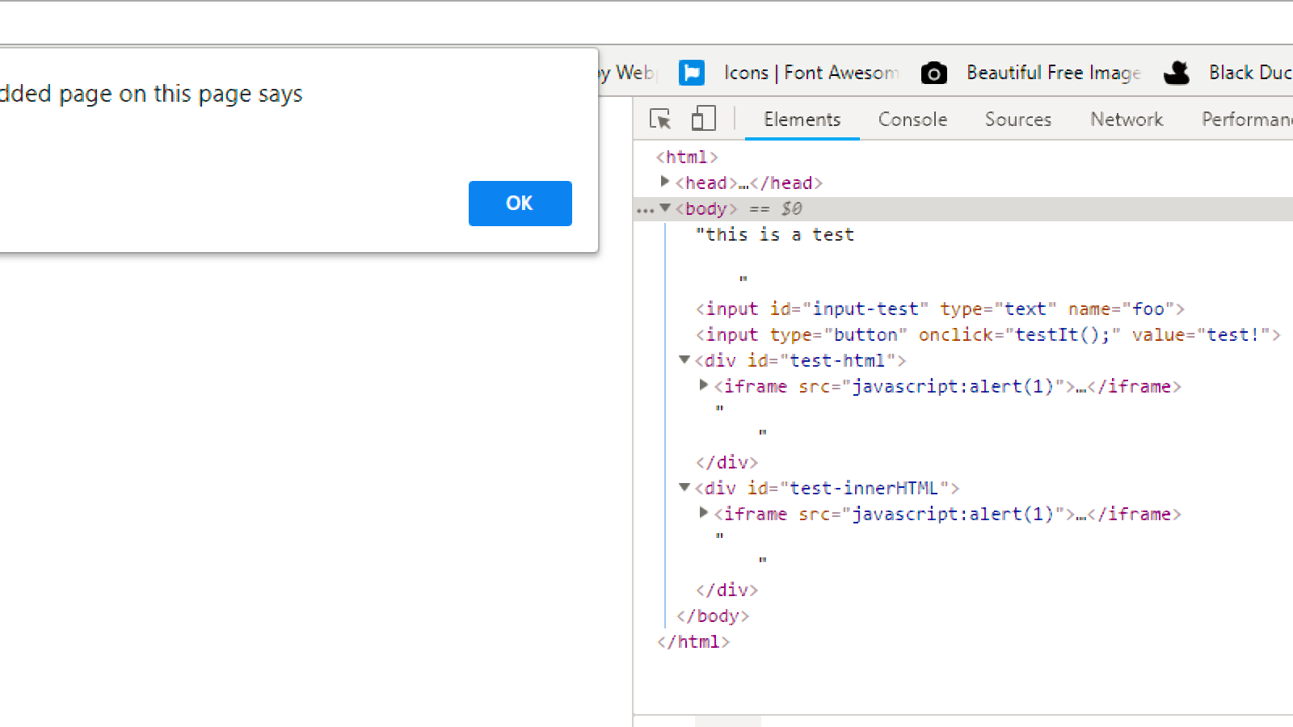
<iframe src=javascript:alert(1)> Will show both alert boxes bypassing the innerHTML

